Slide 1
The Official Study Guide for
THE FIRST BIRTHDAY PARTY EVER!
S
E
SPRING
2021
T
M
Creative Study Guide / Executive Producer Team: Keith Johnson, Letitia Avalos, Marian Marie, Frank Sonderman, Ann Giles, Kecia Brown, Rodney Pickens, Jane Dickerson, Nick Seyferth, Danny Walters, Debra Mc…

Slide 2
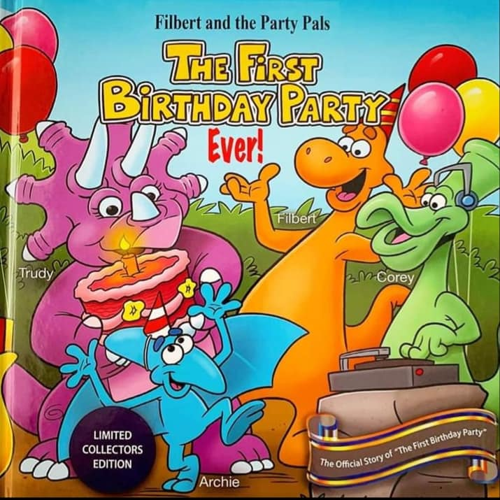
The First Birthday Party Ever!
SYNOPSIS
The First Birthday Party Ever! is a fun story of human-like dinosaurs and animals, filled with suspense, surprise and friendships. A captivating story with fun music for both children and adults. It revolves around Archie, a Pterodactyl who is born in a most unnatural way – his egg is blown from the nest by the eruption of the ChuckleGiggleNu volcano, causing him to be confused about who he is the rest of his life. Not being born with his natural mother who ordinarily would teach her dinosaur offspring to fly, young Archie must learn this and many dinosaur lessons from his newfound un-Pterodactyl- dinosaur mother, Trudy. Trudy tries her best to teach her beloved confused surrogate child-like dinosaur his birthright of flying but to no avail. This devastates young Archie so Trudy decides to cheer up Archie with a surprise birthday party celebrating his First Birthday. Then the fun begins . . . .
Party Poopers Rexton and Albert overhear plans about the celebration and decide to steal their fun by stealing their party favors and cake. All of this against the background of a major storm, the annual car race and concert.
There is mayhem in ChuckleGiggleNu jeopardizing every young dinosaur’s birthright – First Birthday Party.

Slide 3
Math & Science
PLAY
Party Pal’s Study Guide: Intro
“Hello Scientist! I am so excited to tell you what we’re going to do today. Who LOVES dinosaurs? Me too! Does anyone know what people are called that look for dinosaur bones? YES! Exactly! Paleontologist! And that’s what we’re going to be today.
We are going to use our knowledge of our colors, our shapes and sizes to help us find out which dinosaur of Filbert and his Party Pals we have dug up. Are you so excited? Me too! Alright, before we get started, we have to make sure we have the tools we need we need. So we will have a chart here with Filbert and all his Party Pals. We’ll have a color chart to review to make sure you know all your colors or have a friend in the group that does. We’re going to review our shapes and the different sizes because that’s how we’re going to determine the bones to match with our Party Pal Friends…”

Slide 4
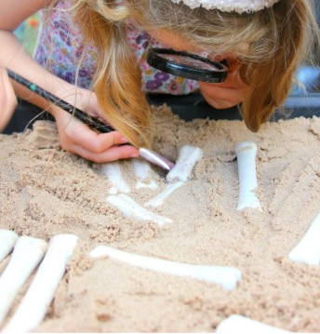
Become A Paleontologist
Let’s Look For Dinosaur Bones!
Objective: Students will be able to identify and match Filbert and Party Pals’ unique bones to each pal.
*Students will utilize their previous knowledge of colors, shapes, and size to help them match dinosaur bones to Filbert and Party Pals.
Materials: Felt poster of Filbert and Party Pals, variety of felt “bones” in different shapes, sizes and colors with Velcro, large plastic tub, shoebox or other container filled with cotton balls, sand or some kind of materials to hide the bones, and supplies for excavation, color flashcards and shape flashcards, large and small objects. We will be supplying kits soon that include tools (hand shovel, hand rake and brush) sand, bones, rulers and container.
Introduction: (Probably would be scripted, but here’s the general idea.) Use the color and shape flashcards to review colors and shapes. Use the large and small objects to review size. (Depending on where this thing is going, maybe the color cards are some of the dinosaurs and simple balloons from the story. Maybe the size cards are the dinosaurs, gifts, and balloons, etc. from the story.)
Show a quick video of anthropologists excavating

Slide 5
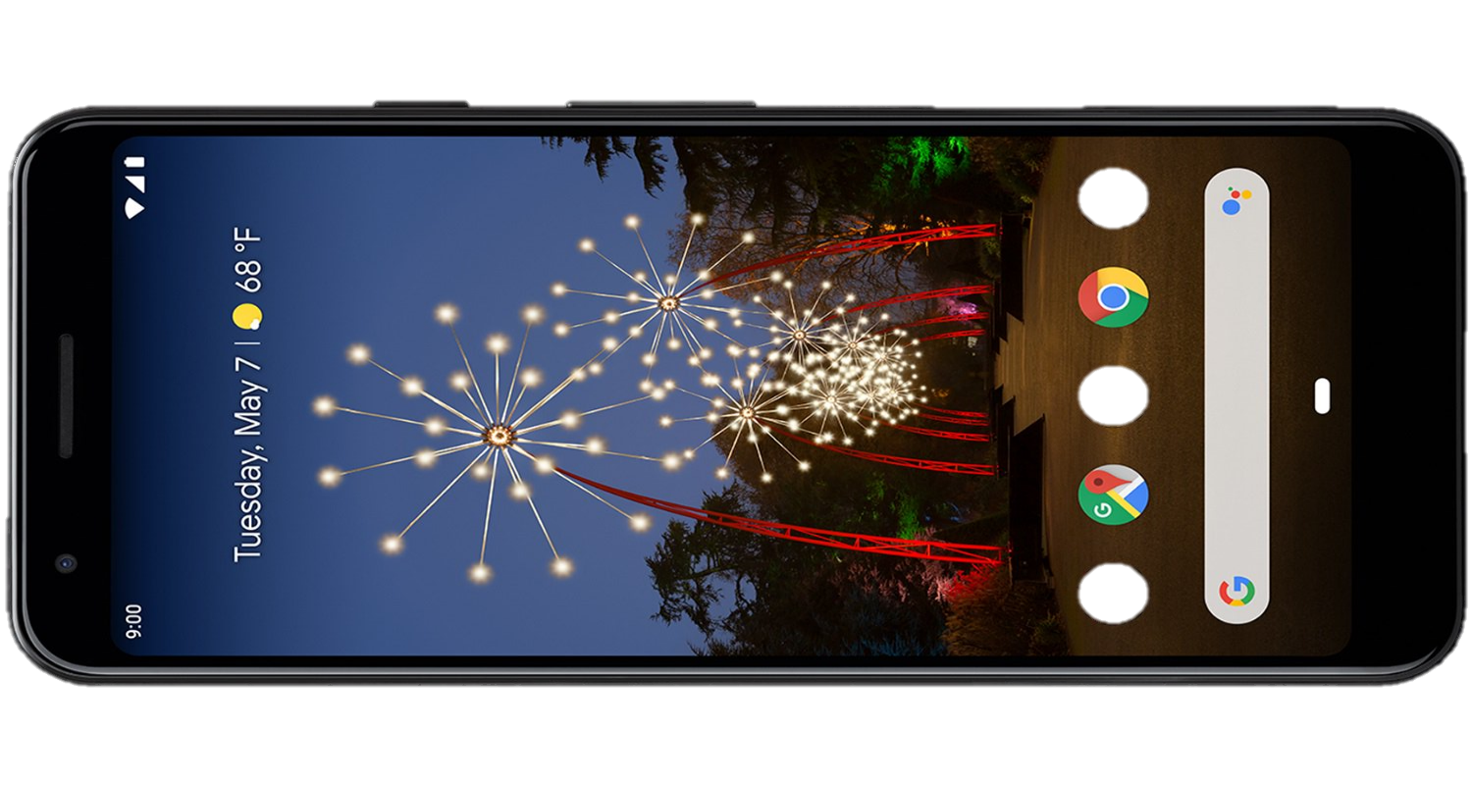
Technology
Welcome to the land of ChuckleGiggleNu where you can see and interact with lively dinosaurs.
All you need is a cell phone and then download our Party Pals Play App and we will go back 70 million years through our time space continuum and re-create an augmented reality that will simulate an image of the daily lives of dinosaurs.
This special technology was engineered in a way that causes the phone to bend light creating the images that you see.

Slide 6
Become A Paleontologist - 2
Instructional Activity: Explain to students they are going to become anthropologists. Break students into small groups of 3 to 4. As students find bones, they need to attach them to the poster. Once the poster is complete, students discuss the characteristics of each bone to explain why they think it belongs to which Party Pal.
Wrap Up: Students present their poster to the teacher and their classmates.
Differentiation: Flashcards use pictures and words. Also, teacher provides realia (real-life shapes of different colors and sizes). These objects help visual and kinesthetic (tactile) learners. Also use heterogeneous groups (mixed levels) so that there is a student that knows the colors, shapes and sizes that can assist other students.
Assessment: Students complete a worksheet or activity on an educational website where they can match shape and size and identify colors.

Slide 7
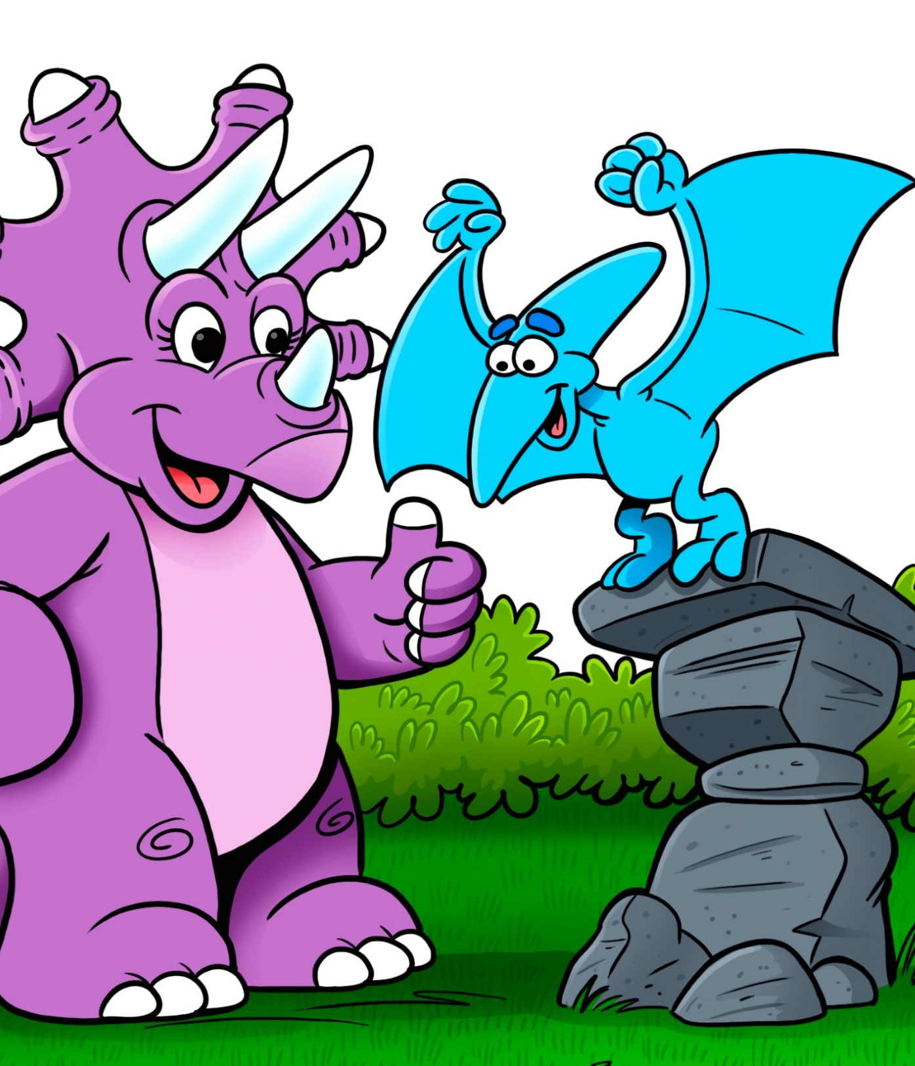
Engineering & Math
PLAY
Objective: Students go on a journey like Archie to learn how to “fly” by engineering paper airplanes and measuring the distance. Which design will go the farthest and why?
*Students will use their previous knowledge of measuring objects.
Materials: A variety of paper (different weights), chalk, and other measurement tools.
Introduction: Students practice measuring different objects using unifix cubes, string, measuring tape, and other objects. Students practice comparing distances by using the phrase, “The ______ is longer than or shorter than the _________.”

Slide 8
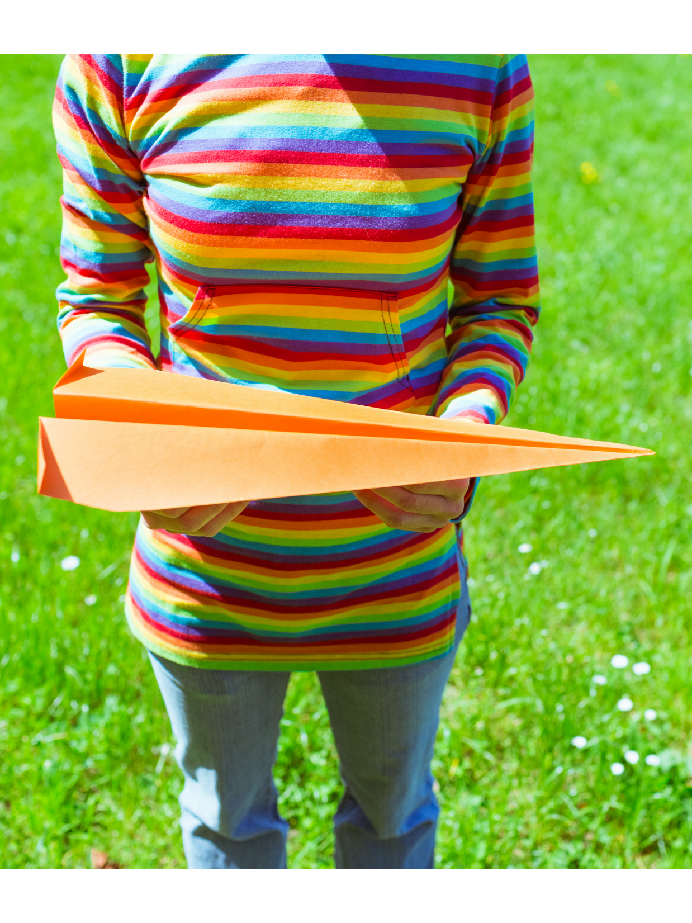
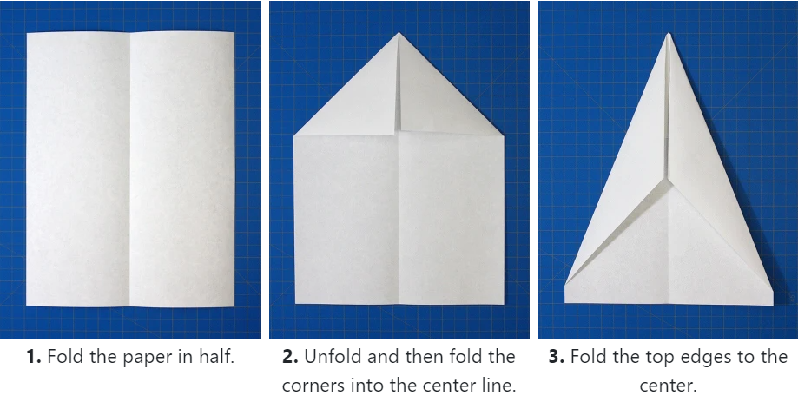
Engineering & Math
Instructional Activity: Students choose 3 different types of paper and decide how to engineer 3 different types of paper airplanes. Once the students have engineered their airplanes, they take them outside to fly them and measure the distance each airplane travels. They will use their measuring tool and mark the distance with the chalk or lawn flags and their name. Students will use a worksheet or science notebook to record each flight. Then they will discuss and/or journal why each paper airplane went the distance it did. We will provide recommended paper, chalk or lawn flags.
Wrap Up: Students compare one of their paper airplanes to Archie to help figure out some reasons why Archie had trouble flying. Present to the class or a small group.

Slide 9
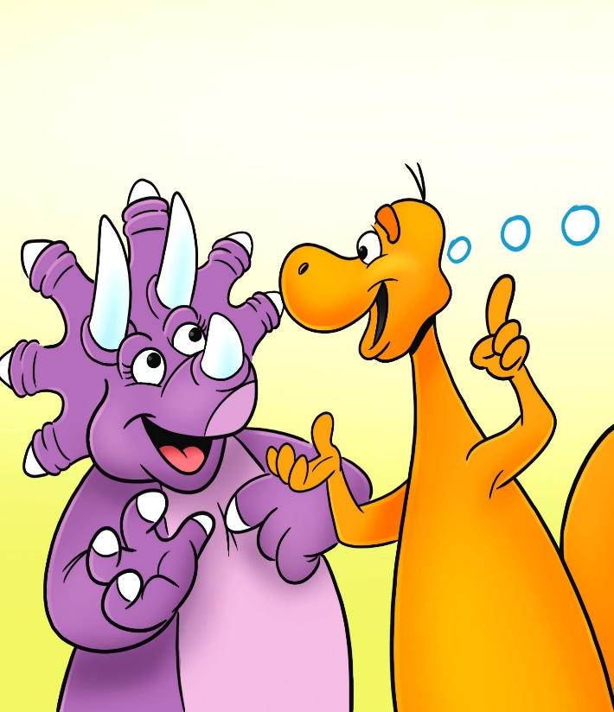
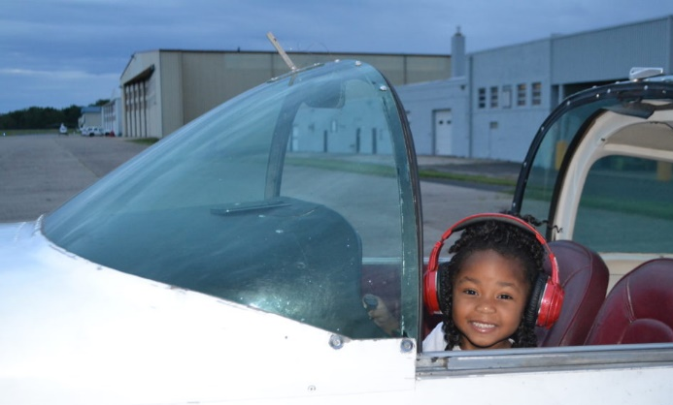
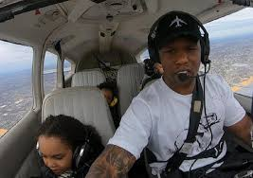
Hey! Maybe we can learn to FLY!
Engineering & Math – (con’t)
Differentiation: Some students may only have the patience to engineer 2 paper airplanes. Students can work in pairs. Provide numerous options for measurement tools.
Assessment: Students are able to compare the distance of each of their paper airplanes by utilizing the phrase from above, “The first paper airplane flew a longer or shorter distance than the second or third paper airplane.” Have a worksheet or science journal students can illustrate and write the comparisons.
Extension Activity: Teacher can incorporate lessons about the wind and how it affected the distance of the paper airplanes’ flight. (Force & Motion)

Slide 10
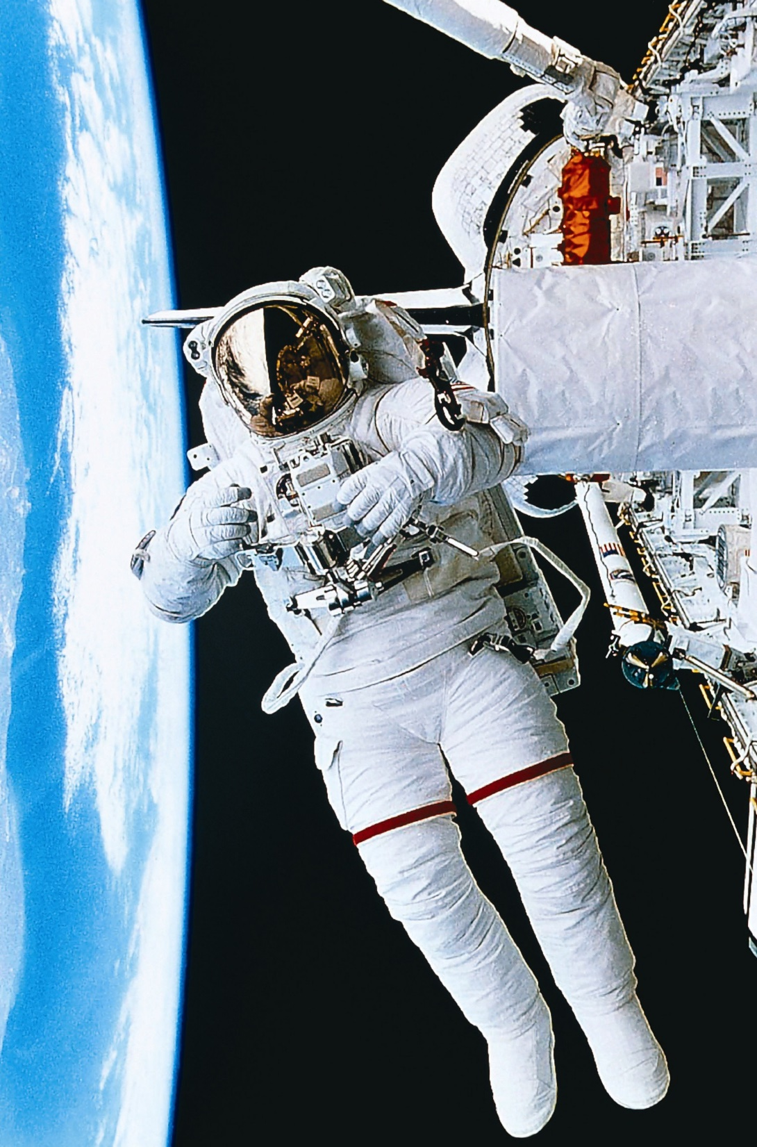
THE S.T.E.M. MAP
The Building Blocks of Advancement.
SCIENCE is the proven facts that we build on. Understanding Science is critical for the success to bringing our dreams and visions to fruition.
TECHNOLOGY is primarily the tools that it takes to develop and advance the ideas based on the facts provided by science for a culture to advance.
ENGINEERING is the ability to create something based on Science, using the tools provided by technology, to bring forth a new and useful product that enhances the quality of life on earth.
MATHEMATICS is the foundation that proves the ideas and theories as we reach into the future continuously solving for “X”; “X” being the unknown.
Become an Engineer! Become a Scientist! Become a Pilot! Become and Astronaut! Just BECOME!

Slide 11
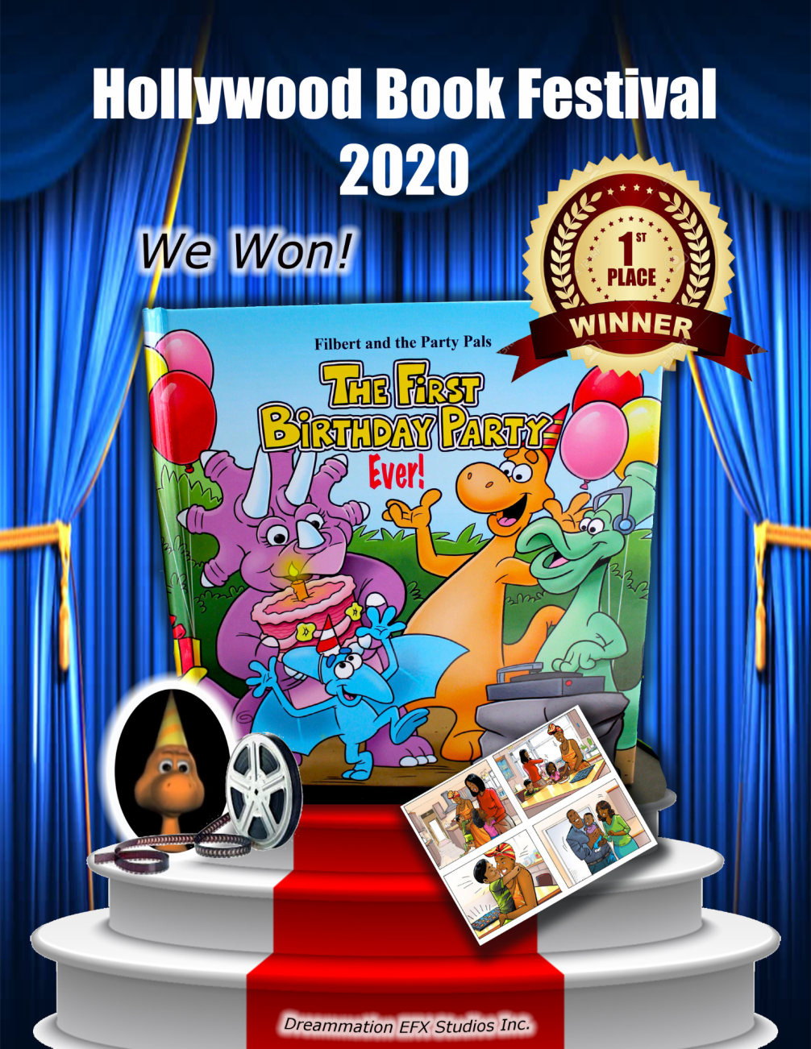
Hollywood Book Festival 2020 – 1st Place!
It is our pleasure to announce that our Children’s book titled “The First Birthday Party Ever!” was awarded 1st Place at the 2020 Hollywood Book Festival. Celebrating books that deserve greater recognition from the film, television, game and multimedia communities, the Hollywood Book Festival aims to spotlight literature worthy of further consideration by the talent-hungry pipeline of the entertainment industry. Our goal is to receive an Academy Award!

Slide 12
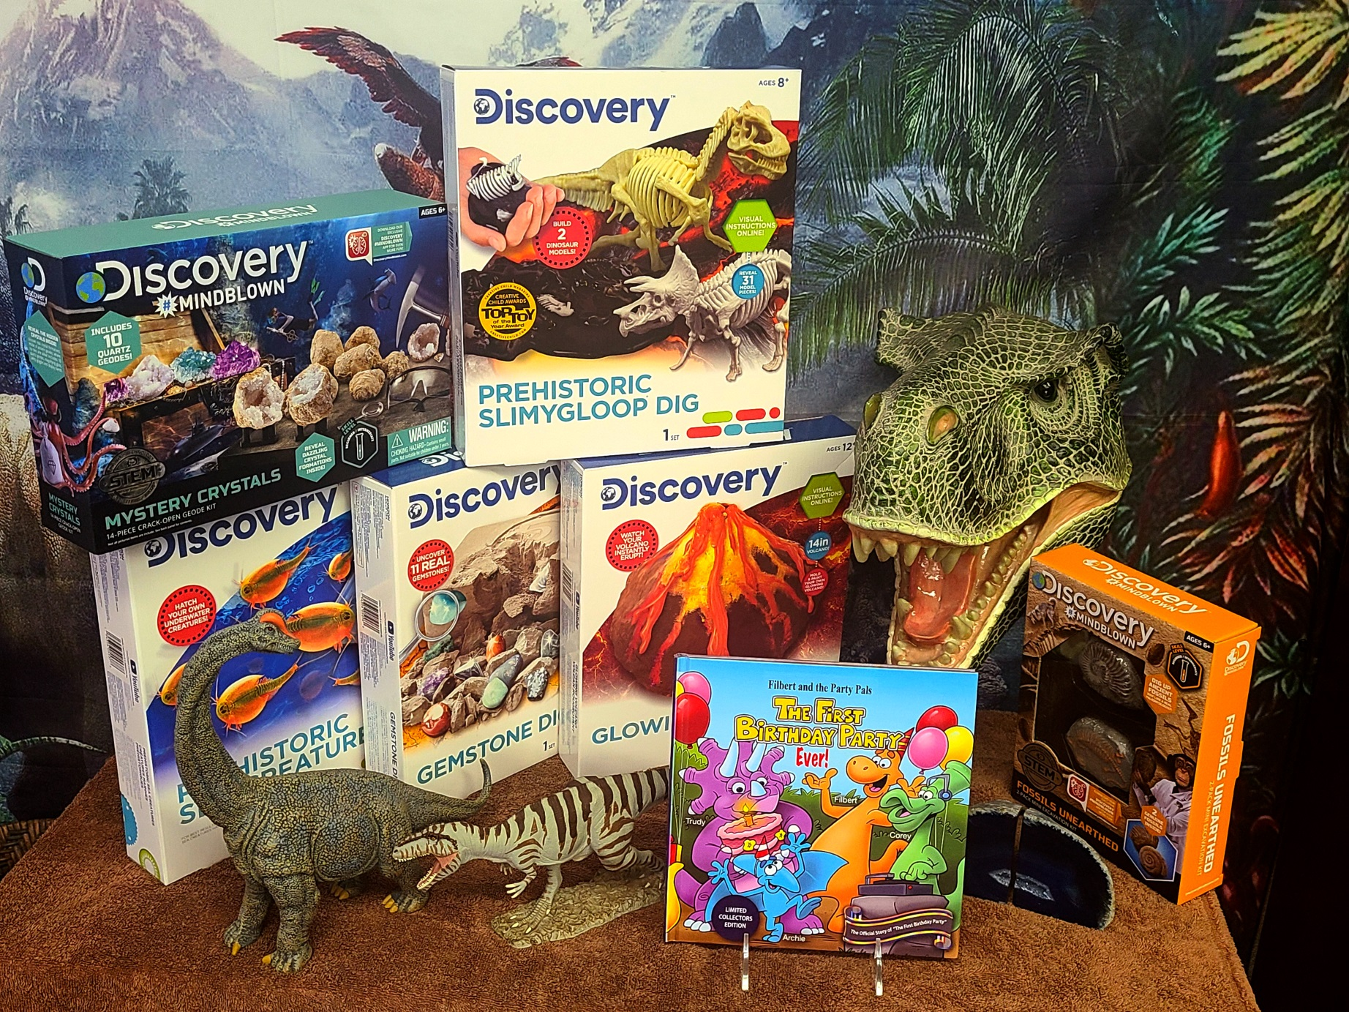
Additional S.T.E.M. Activities included in the Package:
S
E
T
M

Slide 13
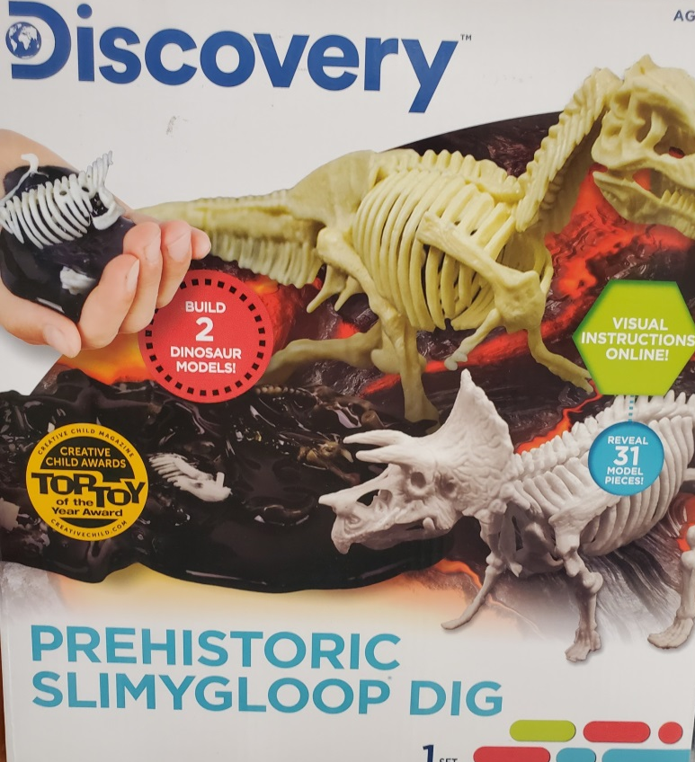
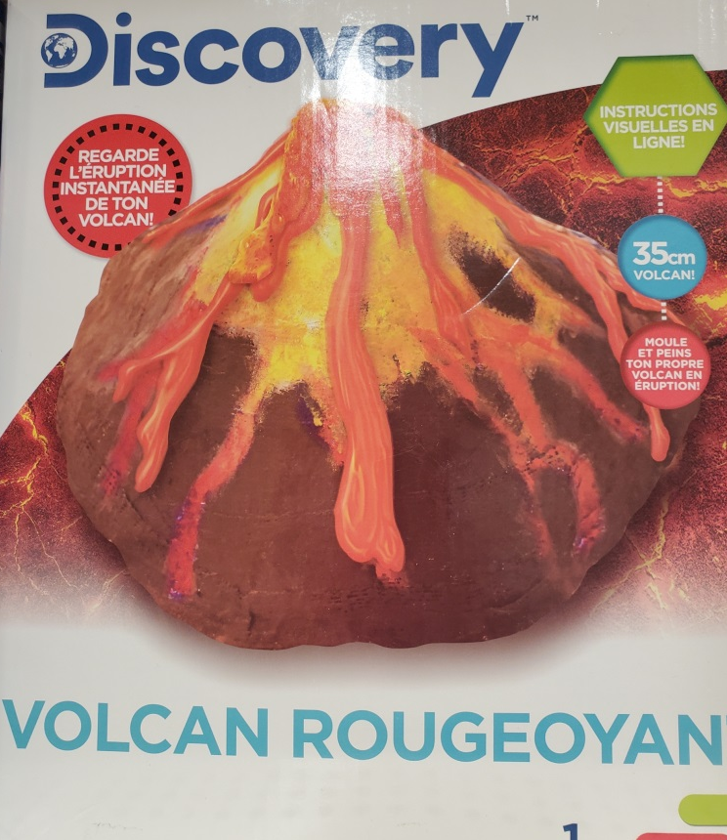
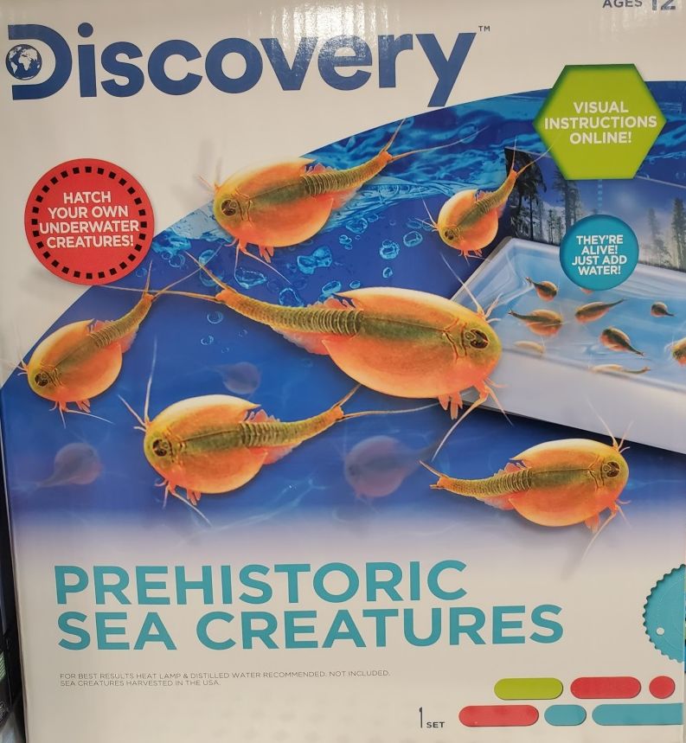
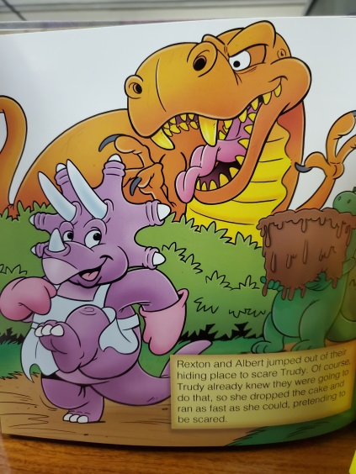
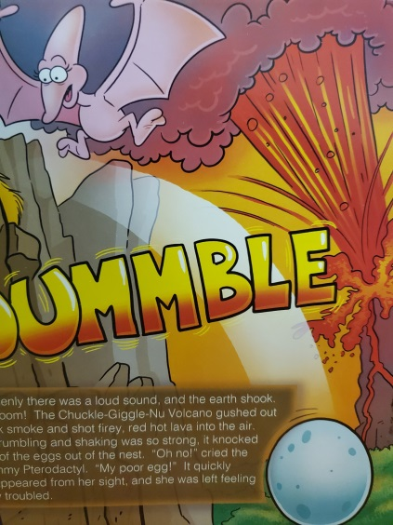
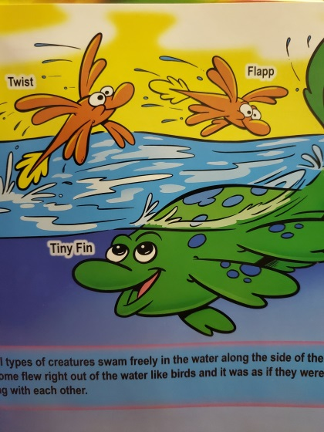
Additional S.T.E.M. Activities included in the Package:

Slide 14
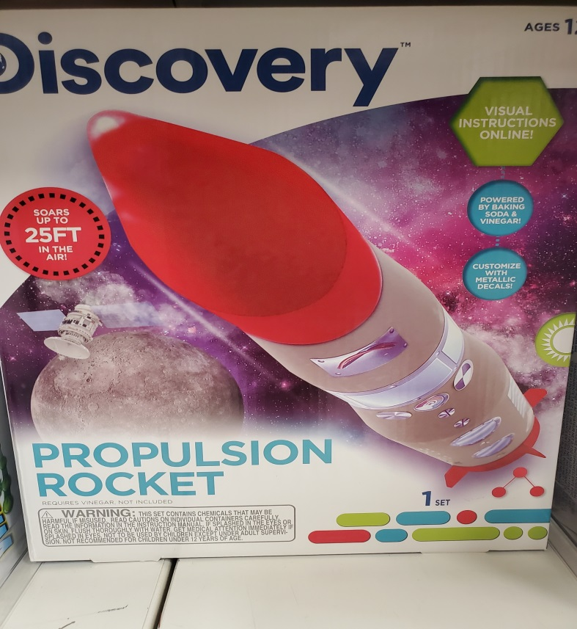
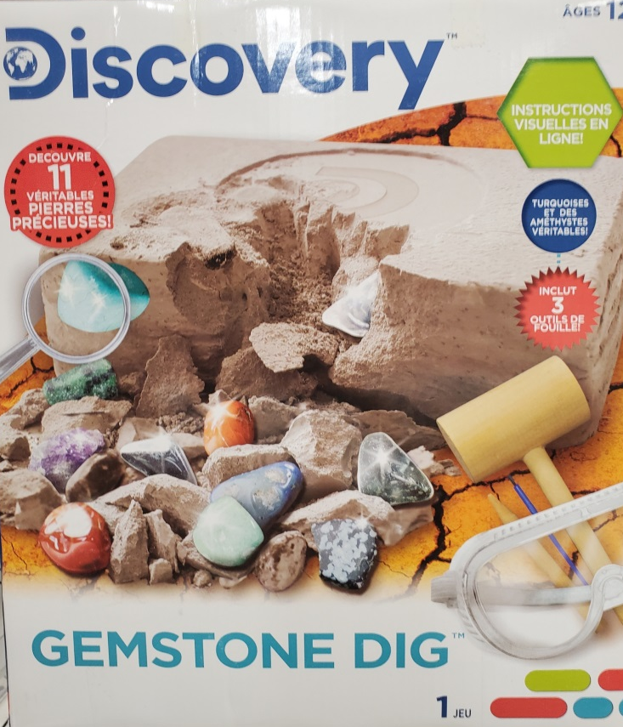
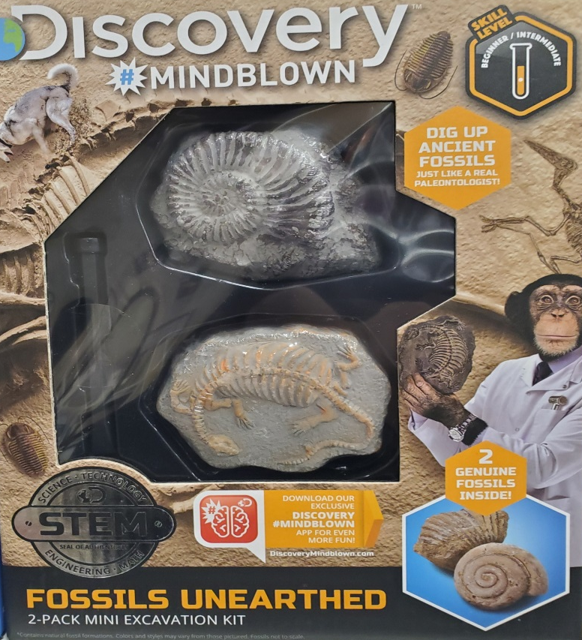
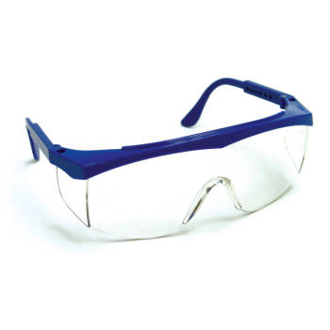
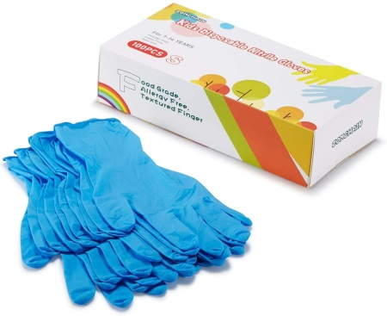
Additional S.T.E.M. Activities included in the Package:

Slide 15
The First Birthday Party Ever – Study Guide Test:
DOWNLOAD PDF TEST

Slide 16
THE END

